Slide 1
Memory Matching Game

Slide 2

"Final Review of Summer internship”
for Engineering 3rd Year
Submitted as part of Summer Internship Project.
G. Bharat Chandra (S170711)
Under the Supervision of:
Mrs. S. Lakshmi Sri mam
Assistant Professor
Department Of computer science & Engineering
Rajiv Gandhi University of Knowledge Technologies
Srikakulam – 532402

Slide 3

Introduction
A memory matching game, also known as a memory tile game is a type of game in which players attempt to match pairs of cards or tiles bearing images, numbers, or words. The game typically starts with the cards or tiles face down, and the player flips two over at a time in an attempt to find a match. The is a single-player game and can be found in various platforms such as mobile apps, online websites, and physical board games.

Slide 4
Abstract
Universities and colleges are the places where students get jam-packed with loads of work like classes, campus jobs or internships, ... etc in a way of attaining future goals. so the days become stressful and restless. On such stressful days students search for stress busters for mind relaxation. we obviously know those are exercising, sleeping and games like BGMI and Call of Duty. Playing such kind of games may lead to adverse things like addiction. But games like memory games may help them sharpen their brains by providing fun and relaxation. Match them is a plain online fun game which makes the player enthusiastic. It calculates and displays the number of moves and time taken by the player to complete a level. Playing memory games creates a positive impact on students in a way to enhance their quick response to problems, stronger attention and concentration. These memory games not only provide fun but helps to improve students critical thinking, attention to detail, and visual recognition.

Slide 5
Motivation of Research Work
I was enthusiastic to develop such a memory game. Now a days the addiction to the mobile games was increasing rapidly that costs people time and health.
The main motive is that in students life to get rid of such addictive games, these memory games are one way.
This memory game is such a stress buster. It develops memory skills in individuals, the interest in understanding how the brain processes and remembers information.

Slide 6
Scope of Project
Design and development of game mechanics and rules, including the matching of cards and scoring system.
Implementation of a user interface for the game, including graphics and animations.
Optionally, the scope can also include the development of a backend system to support online play and leaderboards, as well as monetization through in-app purchases or ads.

Slide 7
Analysis of Existing Methods
There are several methods used in memory matching games, including:
Grid-based layout: This method involves arranging cards in a grid pattern, usually on a board. Players must then flip over cards to reveal the images and try to find matching pairs.
Image-based layout: This method involves displaying a large image, with smaller images hidden within it. Players must then click on the smaller images to reveal them and try to find matching pairs.
Difficulty Level: The game can be set on different difficulty levels, which increases or decreases the number of cards, the time to memorize the images, and the time to find the matching pairs.
Multiplayer: Memory matching game can be designed to be played in multiplayer mode where multiple players play the game and compete with each other.
Augmented Reality/Virtual Reality: Memory matching games can also be designed using AR/VR technology, where players can interact with the game in a more immersive way.

Slide 8
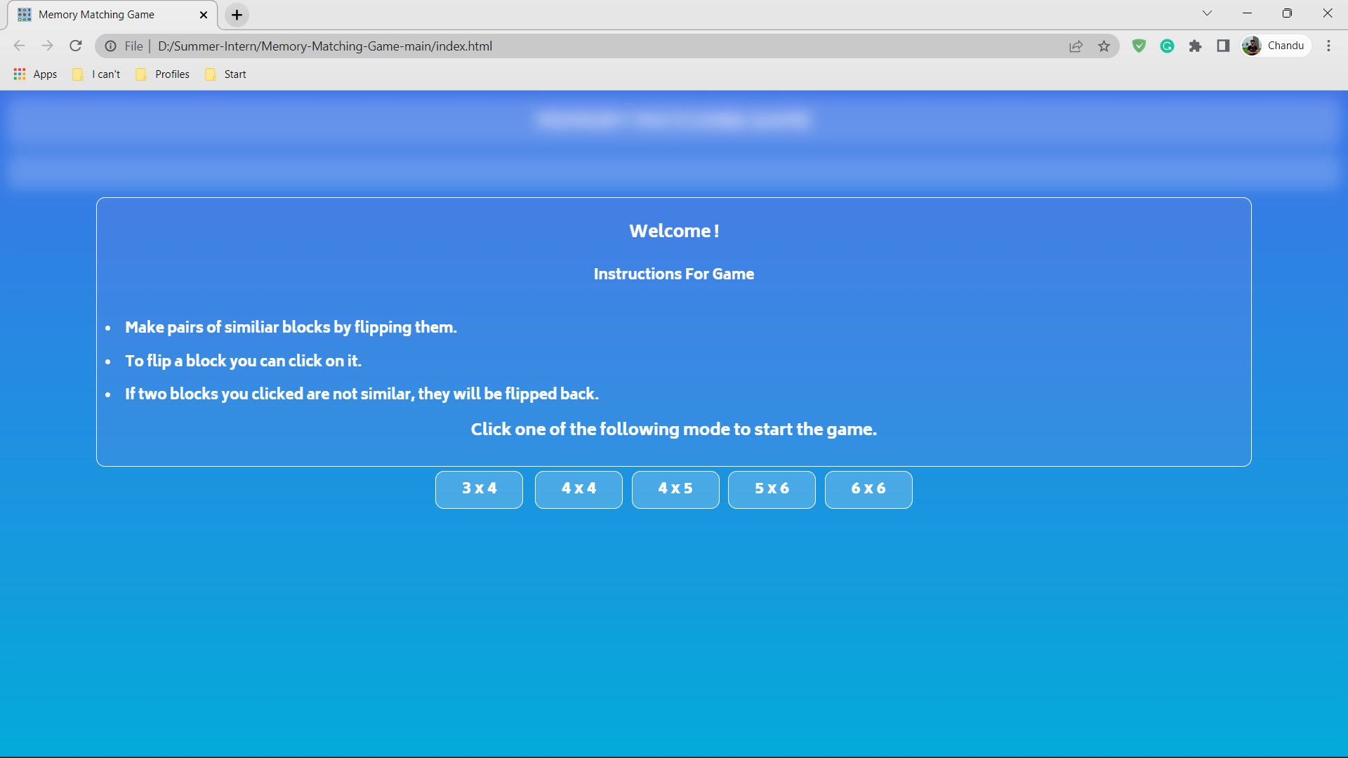
Results and Analysis
Home Page :

Slide 9
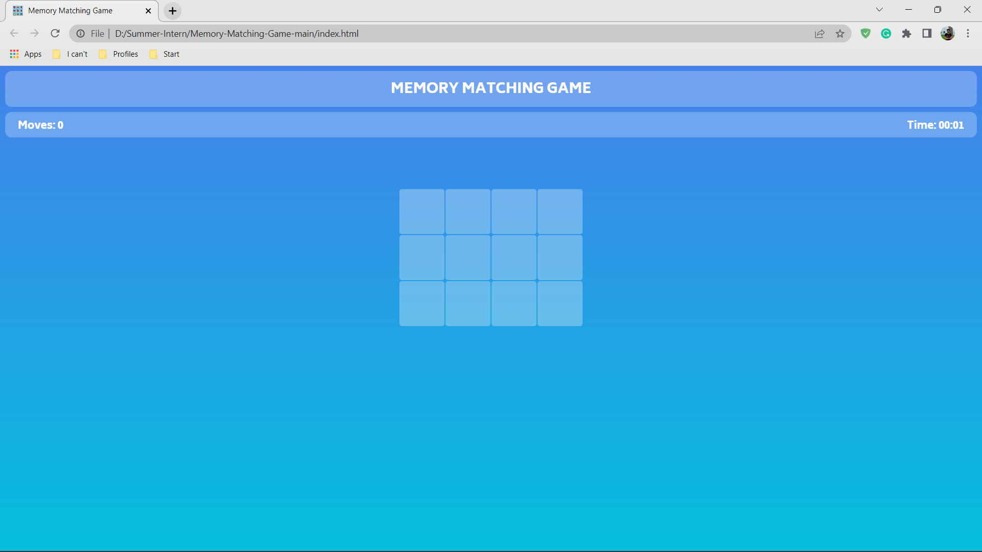
Results and Analysis
Displays GRID :

Slide 10
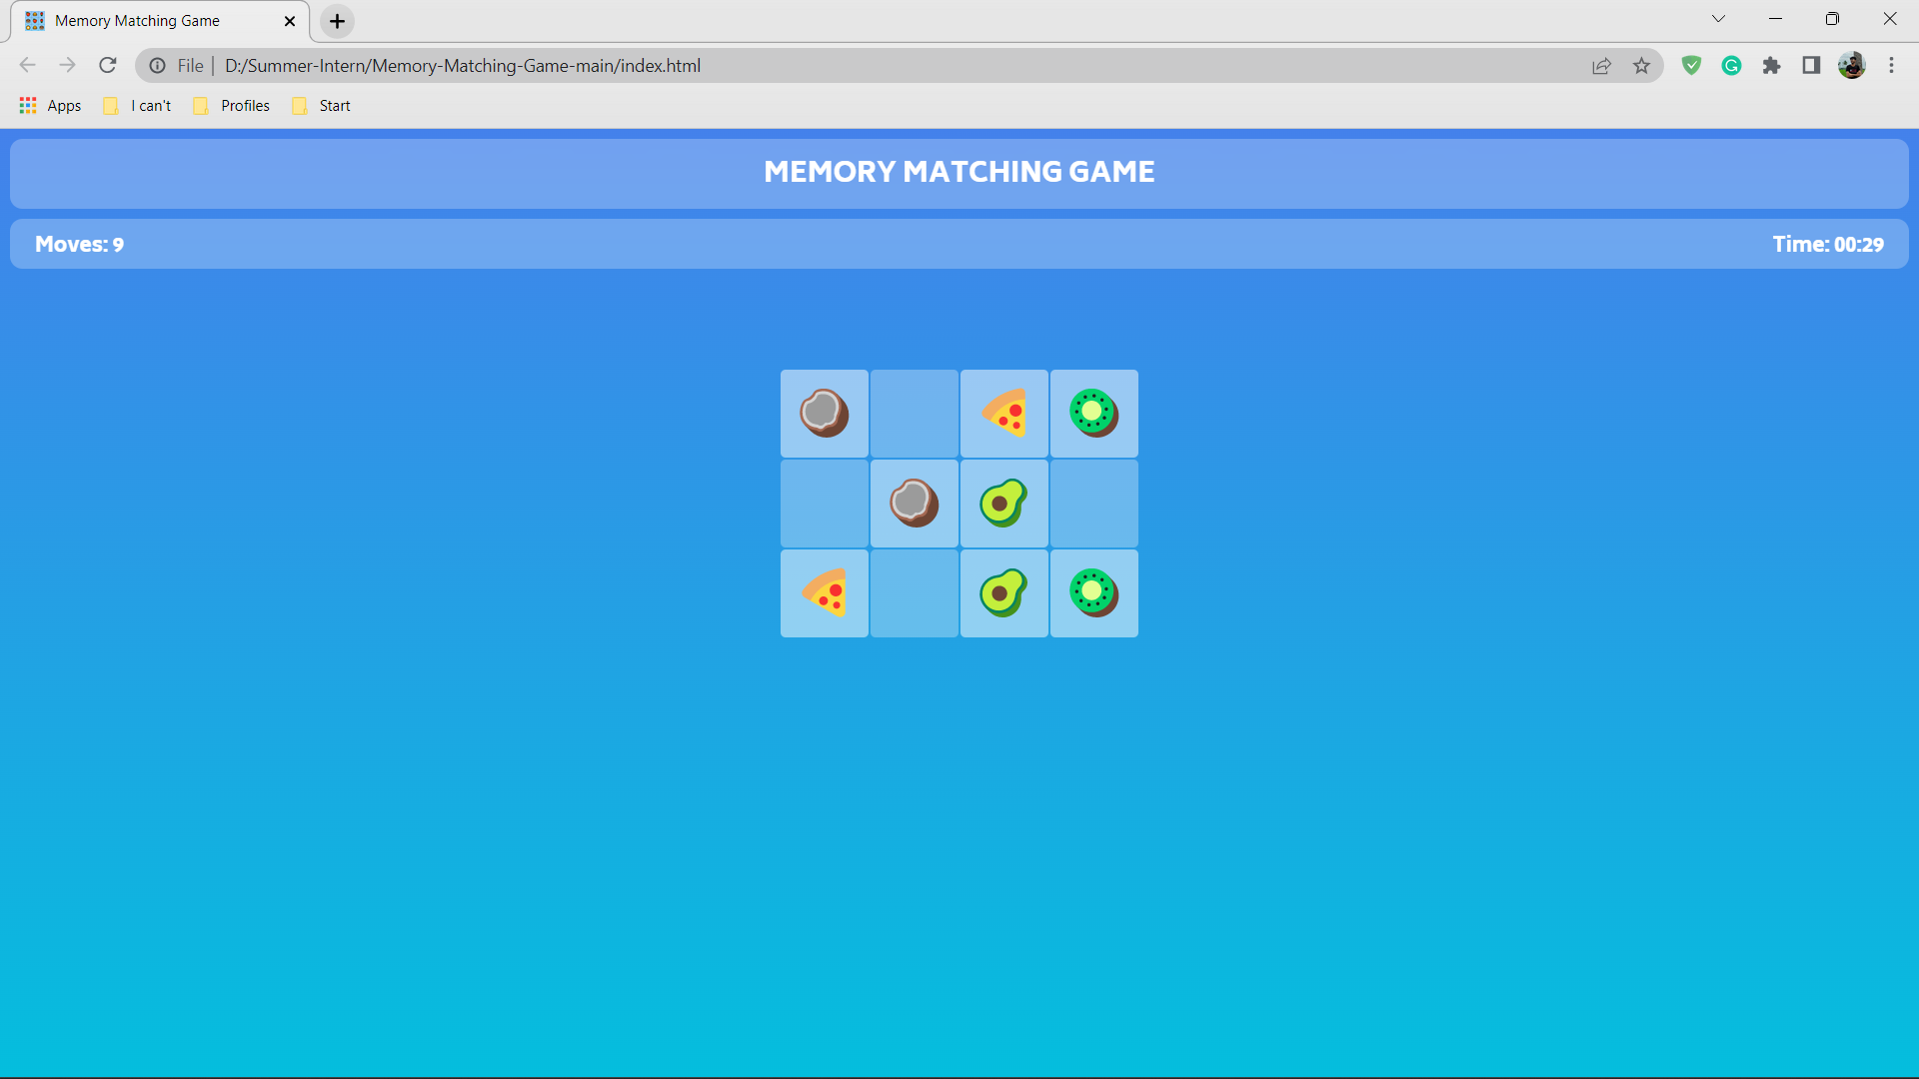
Results and Analysis
Snapshot during the game :

Slide 11
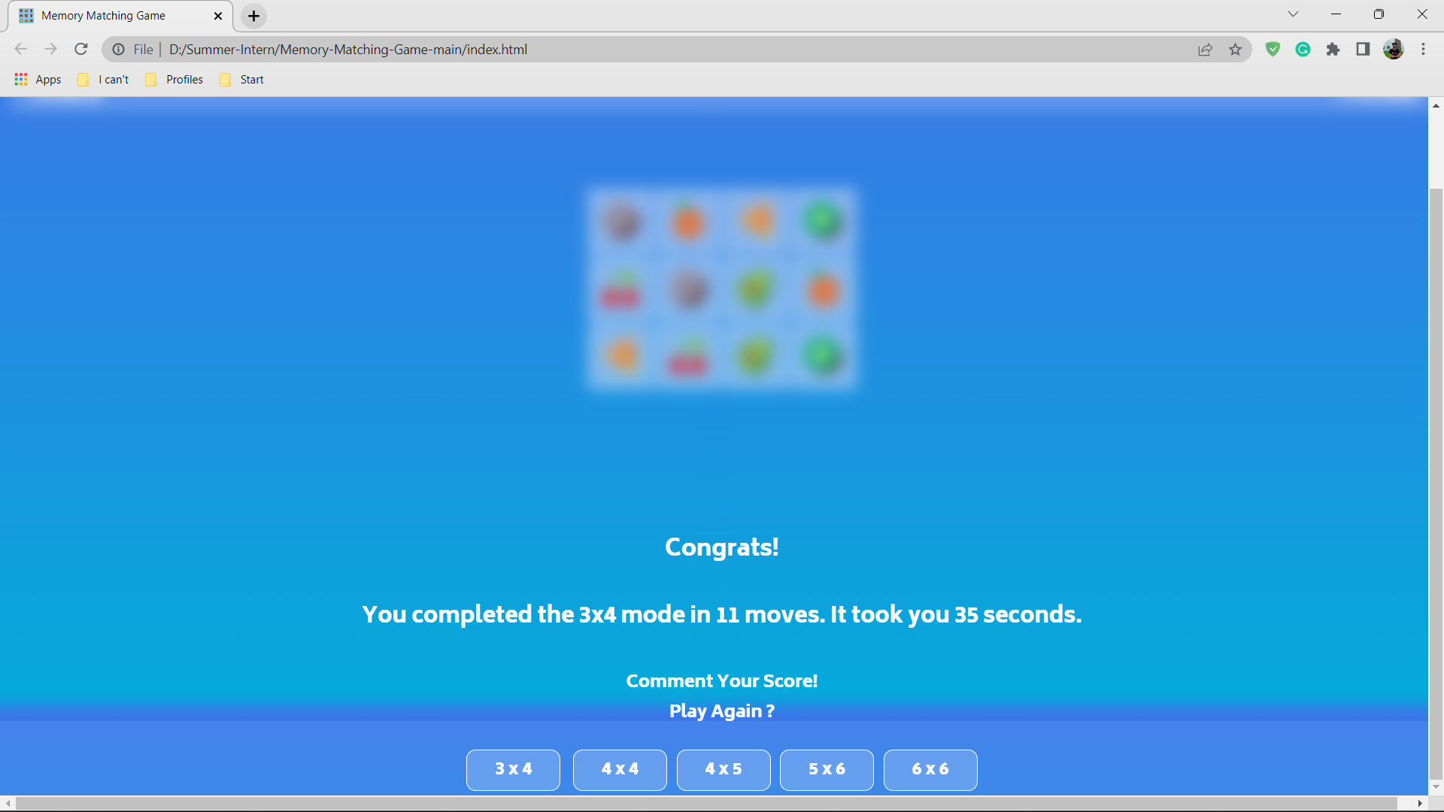
Results and Analysis
Final results :

Slide 12
Conclusion
This project “Memory Matching Game” was successfully developed using HTML, CSS and JavaScript. Compared to existing games, this can be used by both beginners and professionals. Not only a kind of refreshment from a stressful day but this Memory Matching game even helps us to improve our memory power and sharpens our brain.

Slide 13
References
https://www.codingnepalweb.com/build-memory-card-game-html-javascript/
https://marina-ferreira.github.io/tutorials/js/memory-game/
https://www.youtube.com/watch?v=DABkhfsBAWw

Slide 14
Thank You

